Slide 1

Washington State Electric Vehicles
January 2024

Slide 2

Objectives
UPDATE

Slide 3

Questions Addressed
Income
BEV vs. PHEV
How does income affect the likelihood of a consumer to own an EV, and does it affect the brand they will tend to purchase?
What is the ratio of BEV vs PHEV ownership? Does median income make an impact on which of these EV’s one is likely to buy?
Charging Stations
Population Density
Is there a strong correlation between the number of EV charging stations in an area, and EV ownership?
How does the population density of an area effect its EV ownership?

Slide 4

Methodology and Sources
Population:
Washington State Electric Vehicle (BEV or PHEV owners)
Analysis Performed:
TO BE ADDED
Sources:
https://www.kaggle.com/datasets/utkarshx27/electric-vehicle-population-data?resource=download
https://data.census.gov/

Slide 5
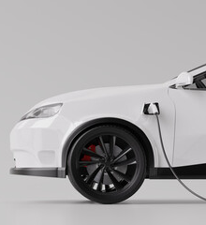
Population
N=
N zip codes
XXX
XXX
Counties
Etc
XXX
XXX

Slide 6

Key Insights
TO BE WRITTEN

Slide 7
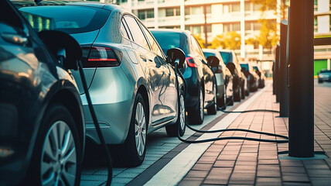
In-Depth Analysis

Slide 8

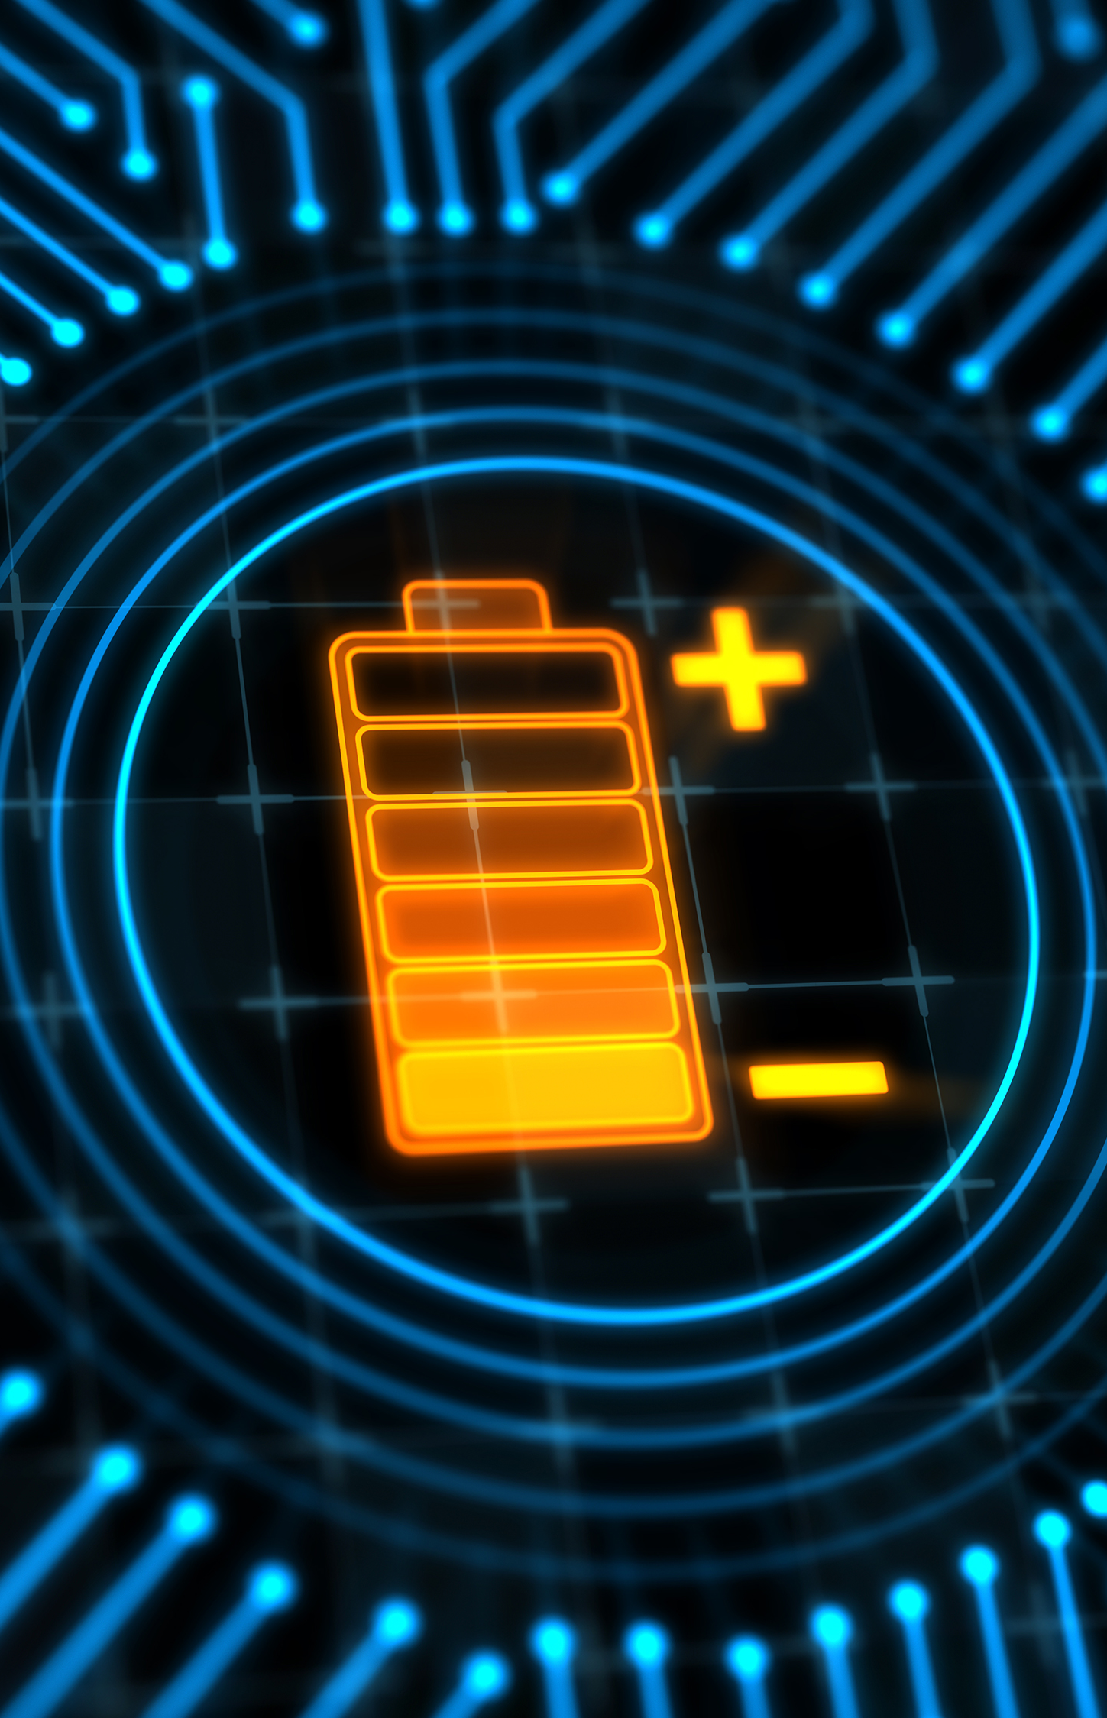
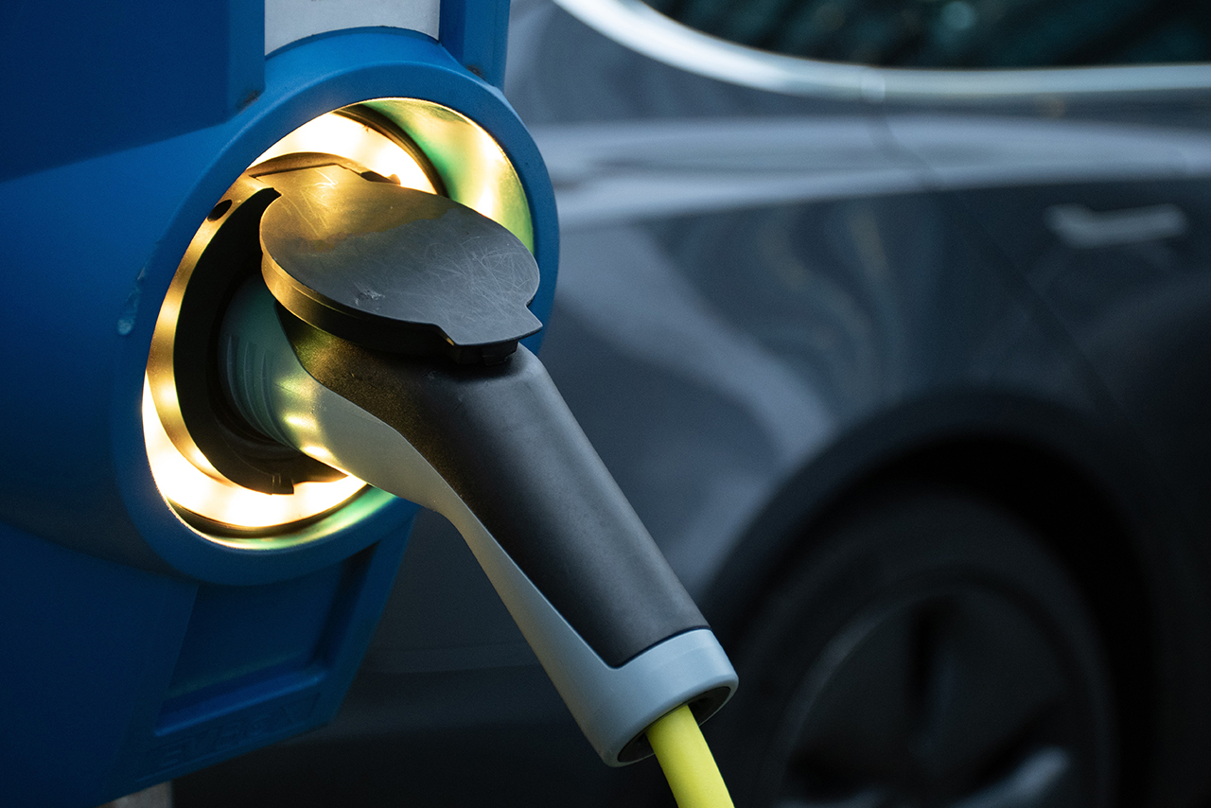

Section One
Income
BEV vs. PHEV
Charging Stations
Population Density

Slide 9

Income Analysis - Charts
TO BE ADDED
Percent EV owned by income
Percent of Make, Make and Model EV owned by income

Slide 10

Income Analysis - Notes
POINT
POINT
NOTES
NOTES

Slide 11
Section Two
Income
BEV vs. PHEV
Charging Stations
Population Density

Slide 12
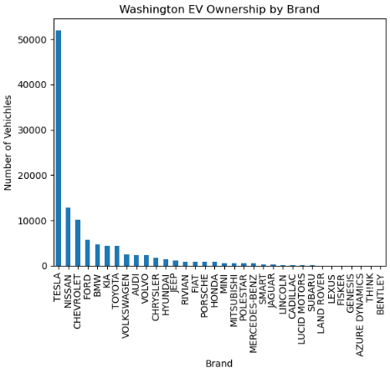
EV Ownership by Brand
NOTE
TO BE ADDED

Slide 13
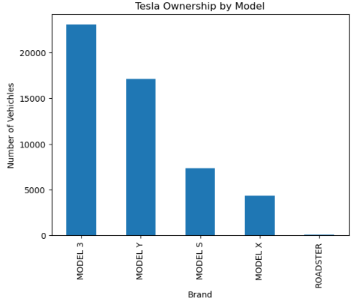
Tesla Ownership by Model
NOTE
TO BE ADDED

Slide 14
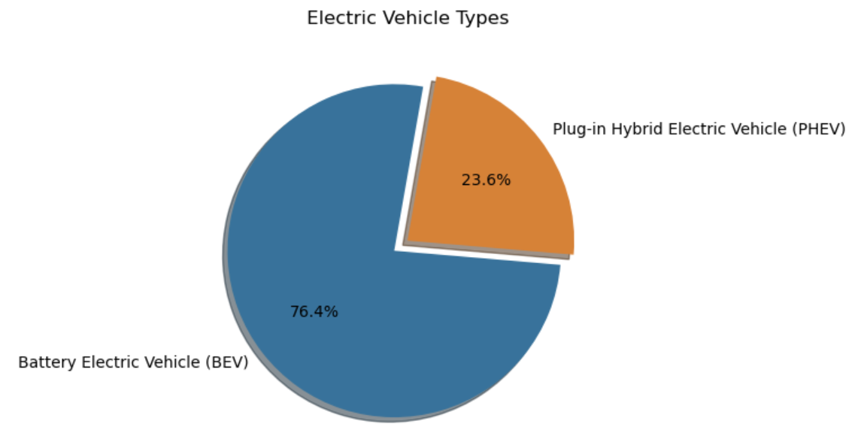
BEV and PHEV Ownership
NOTE
TO BE ADDED

Slide 15
Ownership by Income
BEV vs. PHEV
Percent Purchased by Income Bracket
 | Bracket 1 | Bracket 2 | Bracket 3 | Bracket 4
BEV | 10 | 1100 | $10,000 | $7,000
PHEV | 20 | 200 | $20,000 | $16,000
VISUAL

Slide 16
BEV vs. PHEV Analysis - Notes
POINT
POINT
NOTES
NOTES

Slide 17
Section Three
Income
BEV vs. PHEV
Charging Stations
Population Density

Slide 18
Charging Station Visualization
NOTE
TO BE ADDED

Slide 19
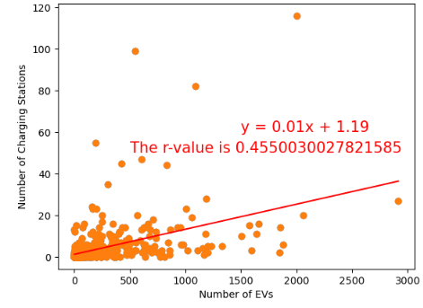
Ownership by Charging Stations
NOTE
TO BE ADDED

Slide 20
Charging Station Analysis - Notes
Method
Result
To determine if there is a correlation between these two factors, our group first obtained a dataset from Transportation.gov listing all public charging EV charging stations in the state of Washington. Next, we ranked the top 10 zip codes according to their population of charging stations and compared those to the top 10 zip codes by EV ownership.
Surprisingly, of our top 10 zip codes with the most EV ownership, not many also appeared on the list of zip codes with the most charging stations. Upon graphing this data in a scatterplot and calculating a linear regression we get a R-Value of ~ 0.46. This supports that there is not a strong correlation between the charging stations available in an area and one’s likelihood to own an electric vehicle.

Slide 21
Section Four
Income
BEV vs. PHEV
Charging Stations
Population Density

Slide 22
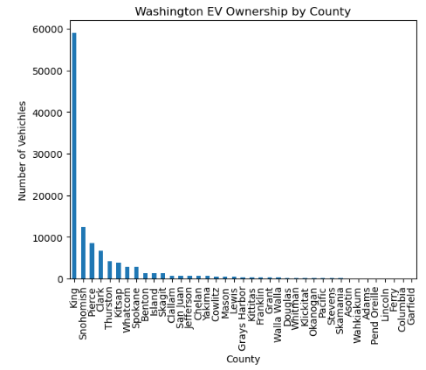
Ownership by County
NOTE
TO BE ADDED

Slide 23
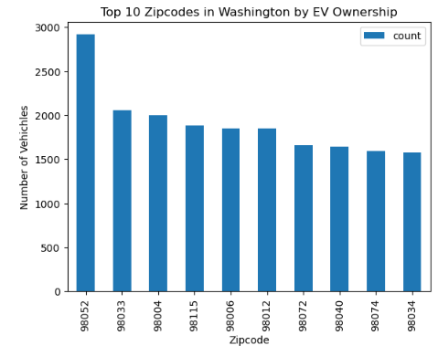
Ownership by Zip Code
NOTE
TO BE ADDED

Slide 24
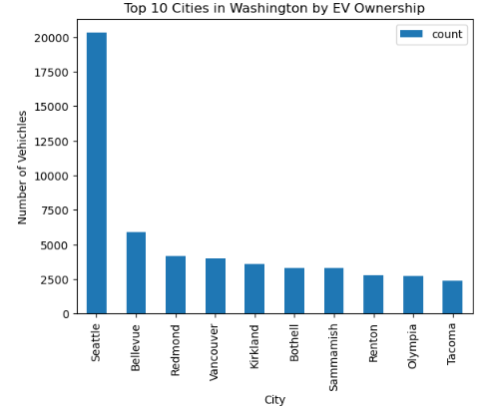
Ownership by City
NOTE
TO BE ADDED

Slide 25
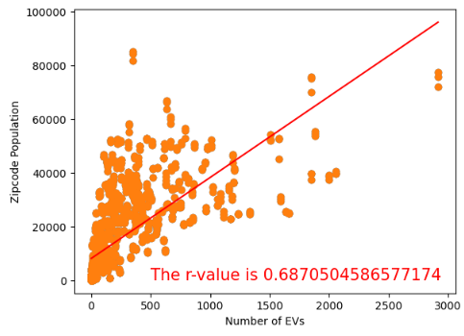
Ownership by Population
NOTE
TO BE ADDED

Slide 26
Population Density Analysis - Notes
POINT
POINT
NOTES
NOTES

Slide 27
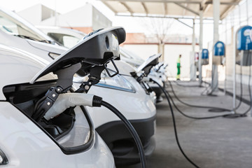
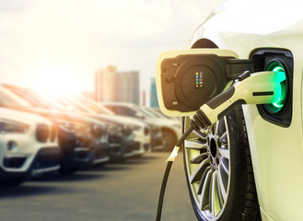
Thank you
Ben Comfort
Barrett Fudge
Charity Ovando
Michael Willis

